Slide 1
Comparative Effectiveness of Shelter in Place
DATA INCUBATOR 2020
Zeinab Gaeini

Slide 2
Does quarantine dampen the curve?
National dispute over effectiveness of shelter-in-place.
Economic lock-down vs control the spread of the disease
Did the state-wide quarantine establishments prevented the spread?
I use the NYTimes COVID-19 tracker data to answer this question in a novel way.
I compare States with similar involvement in the pandemics at the time of shelter-in-place order and assess if earlier action caused relative success.

Slide 3
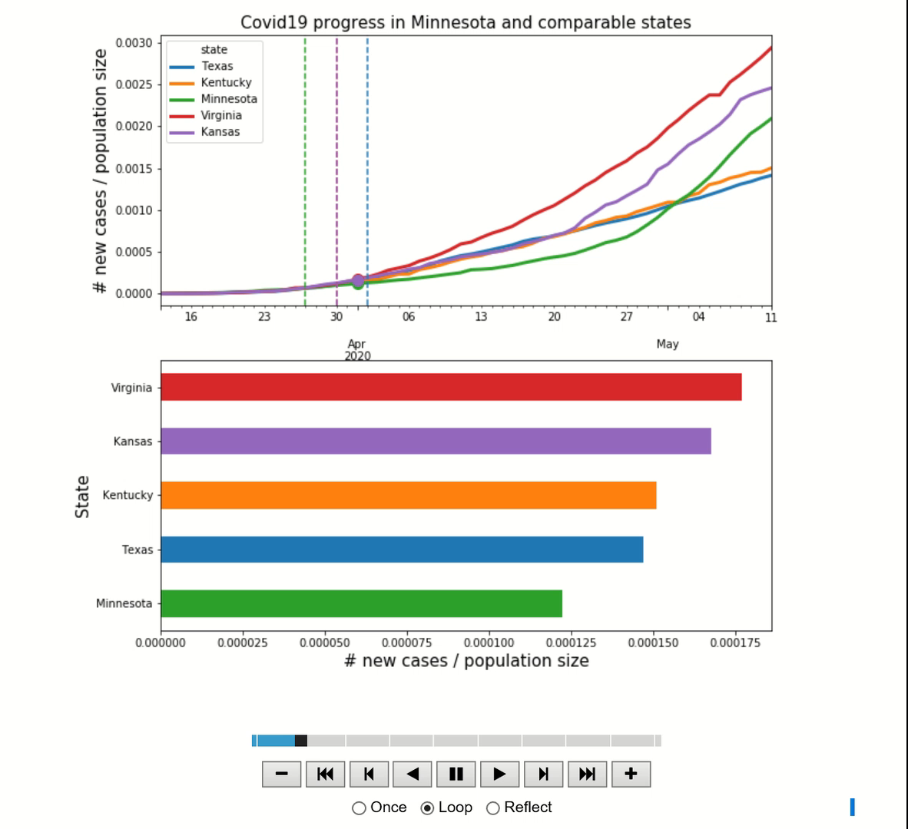
Covid 19 progress in Minnesota and comparable states

Slide 4
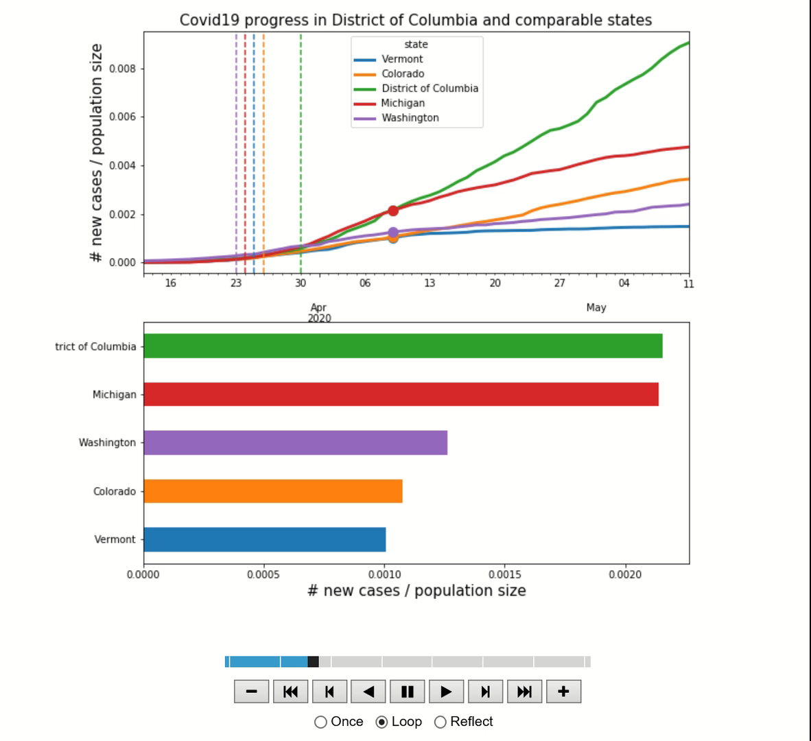
Covid 19 progress in District of Columbia and comparable states

Slide 5
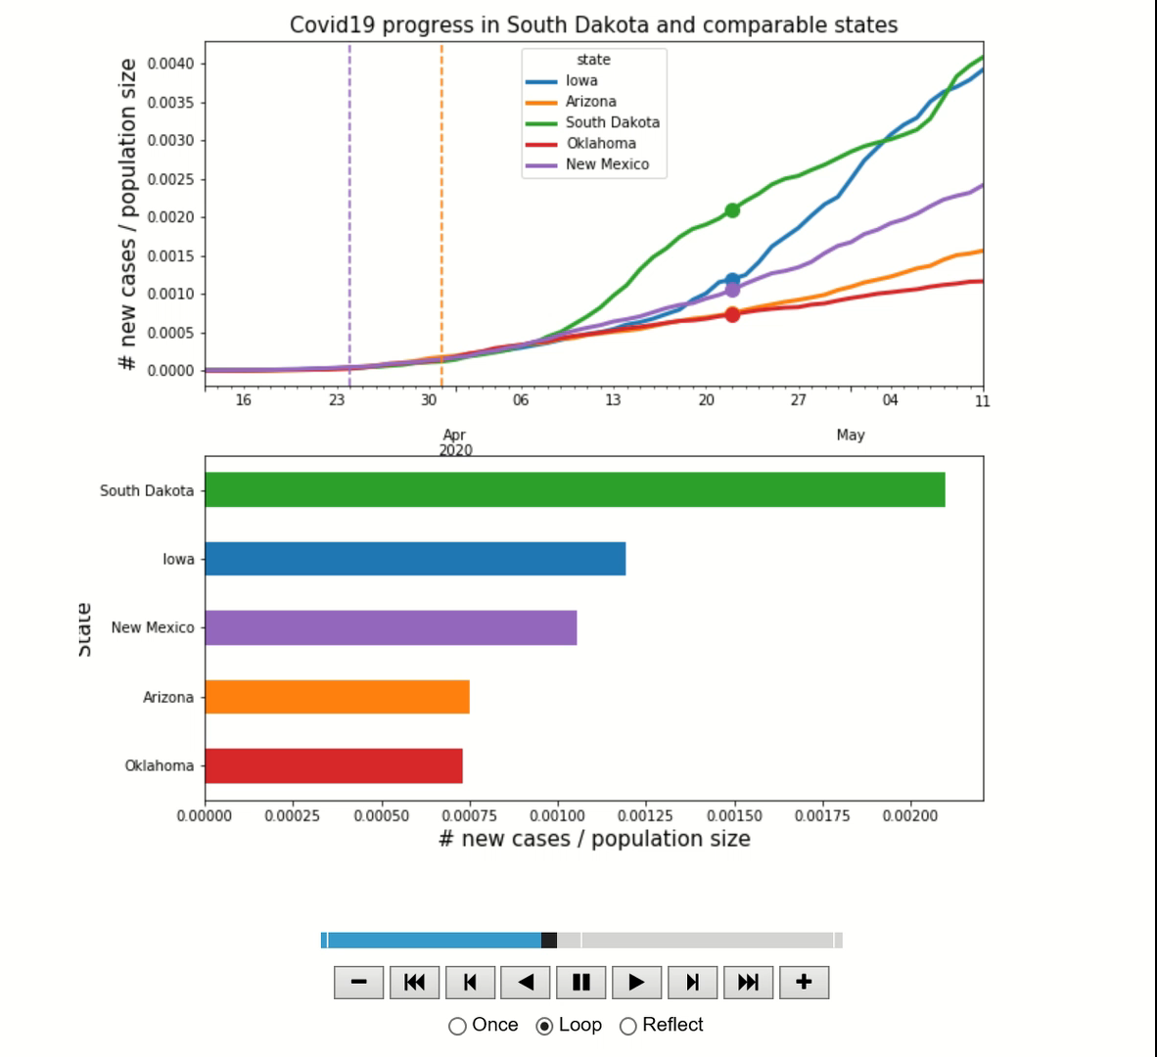
Covid 19 progress in South Dakota and comparable states

